Slide 1
The Study of the Bible
Core Faith
Lesson 5
James F. Davis, PhD

Slide 2
Copyright Notice
You may download this presentation on your computer for personal study or you can print it or use it in a multimedia presentation for yourself and others as long as you give the printed material away and do not charge for it. In this case, free means free. It cannot be bundled with anything sold, nor can you charge for shipping, handling, or anything. It cannot be posted on other websites or servers. It is provided for personal study or for use in preparation and presentation of sermons, Sunday school classes, undergraduate or seminary religion classes or other non-commercial study. Material in the presentation may be edited (added to , deleted or changed) on the condition that no revision contradicts the Bible.org doctrinal statement and that substantive revisions are identified as being the work of a reviser and not that of Dr. Davis.

Slide 3
Overview of the Lesson
The Nature of the Bible
Inerrancy and Challenges to it
The Sufficiency and Authority of the Scriptures (Sola Scriptura)
How did Jesus View the Scriptures
The Canon of the Bible
How we Got our Bible and the History of English Bible Translation
Bible Translation Approaches and Different Modern English Bible Translations

Slide 4
The Nature of the Bible
Inspired by God
Every scripture is inspired by God (2 Tim 3:16; NET Bible).
No prophecy of scripture ever comes about by the prophet's own imagination, for no prophecy was ever borne of human impulse; rather, men carried along by the Holy Spirit spoke from God (2 Pet 1:20-21; NET Bible).

Slide 5
Two Implications of Inspiration
First: The Bible is a human book
1. Authors used their own language, writing methods, style of writing and literary form of writing
2. Authors wrote to an audience in a specific historical context for a specific purpose.
3. The Bible is influenced by the culture in which the author wrote.
4. The Bible has over 40 authors and was written over a time period of 1500 years.

Slide 6
Two Implications of Inspiration
Second: the Bible is a Divine Book:
1. The Bible is inerrant
2. The Bible is authoritative
3. The Bible has unity (66 books; about 40 authors over 1500 years). It has a consistent message and can be compared with itself for proper interpretation.
4. The Bible has an element of mystery: some passages may be hard to understand.
5. The Bible has an interpretation to it that is intended by God

Slide 7
Example of Matt 1:22-23
This all happened so that what was spoken by the Lord through the prophet would be fulfilled: “Look! The virgin will conceive and bear a son, and they will call him Emmanuel.”
1. The OT passage of Isaiah was spoken “by the Lord” (Divine ultimate source)
2. The OT passage of Isaiah was spoken “through the prophet.” (Human intermediate source)

Slide 8
The Nature of the Bible
Definition of Inspiration: The act of the Holy Spirit in which He superintended the writers of Scripture so that, while writing according to their own styles and personalities, they produced God’s Word, written, authoritative, and free from error in the original writings (Paul Enns, The Moody Handbook of Theology, 638)

Slide 9
The Nature of the Bible
Definition of Inerrancy: The teaching that since the Scriptures are given by God, they are free from error in all their contents, including doctrinal, historical, scientific, geographical, and other branches of knowledge (Paul Enns, The Moody Handbook of Theology, 638)

Slide 10
The Nature of the Bible
Some Challenges to Inerrancy:
Alleged Contradictions of the Bible with Science
Alleged Contradiction of the Bible with History
Alleged Contradictions of the Bible with Itself

Slide 11
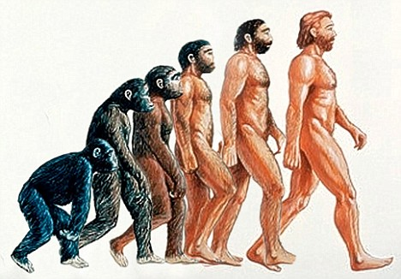
Alleged Scientific Discrepancy
Evolution is often stated but macro-evolution (one species evolving to another species) is theory and not a fact. It has never been observed and not subject to the scientific method.

Slide 12
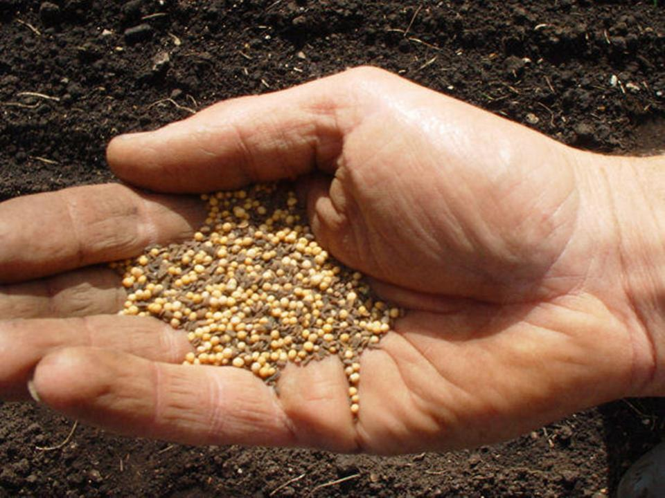
Alleged Scientific Discrepancy
Matthew 13:31 He gave them another parable: “The kingdom of heaven is like a mustard seed that a man took and sowed in his field. 13:32 It is the smallest of all the seeds, but when it has grown it is the greatest garden plant and becomes a tree, so that the wild birds come and nest in its branches.”

Slide 13
Alleged Scientific Discrepancy
Veracity of inerrancy problem for some: The wild orchid seed is smaller.
The statement is proverbial
Jesus is referring only to sown seeds; The wild orchid is not a sown agricultural seed.
Within the Judean world view in their context it was the smallest seed

Slide 14
Once Alleged Historical Discrepancies
Prior to the advent of the archeological era of the 19 and 20th centuries critics often called into question the historicity of the Bible especially the OT in terms of places, peoples and events.
However, over time archeological discoveries have often silenced specific historical criticism.

Slide 15
Three Examples of (Once) Alleged Historical Discrepancies (validated by archeological finds)
The Hittite Empire
In 1876 and later in 1906 evidence of the Hittite capital and language was discovered at Boghaz-koy in modern Turkey.
The Cities of Sodom and Gomorrah
Starting in 1924 excavations were done in the area of the Dead Sea and evidence of cities which had been burned is present during the time of the biblical account.
King David
In 1993 at Tel Dan in Northern Israel a 9th century BC inscription was discovered referring to the “King of Israel” and the “House of David.”
See Patrick Zukeran, http://bible.org/article/archaeology-and-old-testament

Slide 16
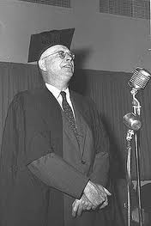
William F. Albright
Prominent Archeologist and professor at John Hopkins (1930-1958)
"There can be no doubt that archaeology has confirmed the substantial historicity of Old Testament tradition." – (William F. Albright, Archaeology and the Religions of Israel. Johns Hopkins University Press, Baltimore, 1956, p. 176.)
"

Slide 17
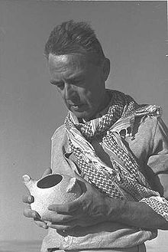
Nelson Glueck, Archeologist and President of Hebrew Union College
"It may be stated categorically that no archaeological discovery has ever controverted a Biblical reference. Scores of archaeological findings have been made which confirm in clear outline or exact detail historical statements in the Bible. And, by the same token, proper evaluation of Biblical description has often led to amazing discoveries." - Dr. Nelson Glueck, Rivers in the Desert, (New York: Farrar, Strous and Cudahy, 1959, 136).

Slide 18
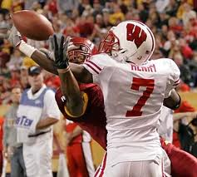
Alleged Bible Contradictions
Differences in parallel passages do not require actual contradictions
Harmonization and understanding that nature of historical reporting most often provides good solutions to differences.
For example in a football game on a pass interference play one reporter states the cornerback bumped the receiver while another states the receiver bumped into the cornerback. Both statements while different may be true but they are being reported from a little different perspective.

Slide 19
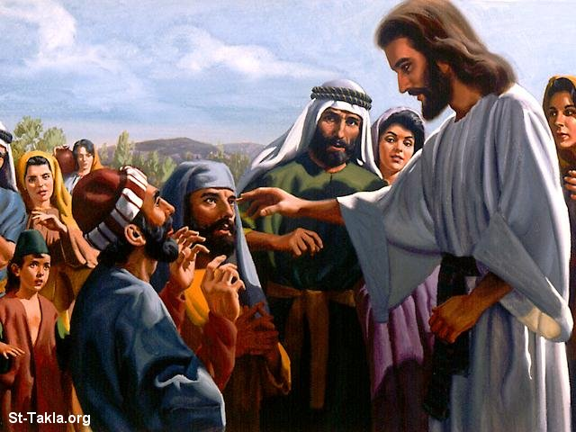
Alleged Bible Contradictions
Two Blind Men or One?
As they were leaving Jericho, a large crowd followed them. Two blind men were sitting by the road. When they heard that Jesus was passing by, they shouted, “Have mercy on us, Lord, Son of David!” (Matt 10:29-30)
They came to Jericho. As Jesus and his disciples and a large crowd were leaving Jericho, Bartimaeus the son of Timaeus, a blind beggar, was sitting by the road. When he heard that it was Jesus the Nazarene, he began to shout, “Jesus, Son of David, have mercy on me! (Mark 10:46-47)””

Slide 20
Alleged Bible Contradictions
Harmonization?
Mark chooses to focus on one of the blind men naming him.
Matthew writing to a Jewish audience may wish to confirm the testimony of the blind men (Jesus = the son of David = a Messianic title) by the Jewish required number of at least two (Deut 17:6).
Because Mark reports that one blind man was healed it does not preclude that another blind man was healed on the same occasion.

Slide 21
Alleged Bible Contradictions
How does one explain the following differences in Peter’s confession at Caesera Phillipi?
Question
Mt 16:13: Who do people say the Son of Man is?”
Mk 8:27 “Who do people say I am?
Lk 9:18 “Who do the crowds say I am?”
Answer
Mt 16:16 “You are the Christ, the Son of the living God
Mk 8:29 “You are the Christ”
Lk 9:20 “The Christ of God”
Sometimes the Bible authors condense speeches and events. This is the nature of historical reporting.

Slide 22
Alleged Bible Contradictions
The Time of the Crucifixion:
And it was the third hour when they crucified Him. (Mk15:25)
When Pilate therefore heard these words, he brought Jesus out, and sat down on the judgment seat at a place called The Pavement, but in Hebrew, Gabbatha. ¹⁴ Now it was the day of preparation for the Passover; it was about the sixth hour. And he said to the Jews, "Behold, your King!“ (Jn 19:13-14)

Slide 23
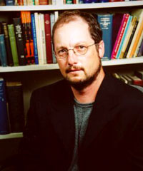
Bart Ehrman, Jesus Interrupted: Revealing the Hidden Contradictions in the Bible, 2009
Bart Ehrman states on this issue: ”It is impossible that both Mark’s and John’s accounts are historically accurate, since they contradict each other on the question on when Jesus died” (pg. 29).

Slide 24
Alleged Bible Contradictions
Reasonable solution (BF Westcott is one commentator who argues this):
John is using a Roman time reckoning system that started the day at 12:00 midnight while Mark and the other Synoptics are using a Jewish time reckoning system which starts the day at 6:00 am

Slide 25
Simple Deductive Argument for Inerrancy
God cannot err. (John 14:6; Heb 6:18)
The Bible is the Word of God (Mark 7:13; John 10:35; Rom 9:6).
Therefore, the Bible cannot err. (See Norm Geisler, http://www.inplainsite.org/html/alleged_bible_errors.html).

Slide 26
The Authority and Sufficiency of the Bible?
Sola Scriptura from the Latin = “by Scripture alone was one of the themes of the reformation” sometimes summarized as the 5 solas.
Simply it means that the Scripture alone is our supreme authority to all other authorities in matters of faith and practice.
For the word of God is living and active and sharper than any double-edged sword, piercing even to the point of dividing soul from spirit, and joints from marrow; it is able to judge the desires and thoughts of the heart. (Heb 4:12)

Slide 27
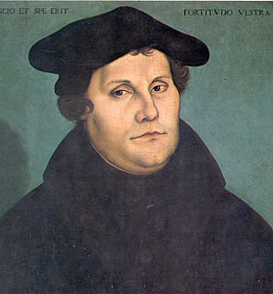
The Authority and Sufficiency of the Bible?
As Martin Luther said, "The true rule is this: God's Word shall establish articles of faith, and no one else, not even an angel can do so” (Martin Luther, Smalcald Articles II, 15)”

Slide 28
How Did Jesus View the Bible?
Jesus said “I tell you the truth, until heaven and earth pass away not the smallest letter or stroke of a letter will pass from the law until everything takes place (Matt 5:18)”.
If those people to whom the word of God (= OT Psalm) came were called `gods' (and the scripture cannot be broken)(John 10:35)

Slide 29
The Canon of the Bible
Definition of the Canon: from Greek word kanon meaning reed or straight rod thus a “standard.” By the 4th century A.D. for the New Testament it is what was applied to a list or collection of books that met a prescribed standard.
Now the canon refers to the closed collection of Jewish and early Christian writings that constitute divinely inspired, authoritative Scripture for the beliefs and practices of the church.

Slide 30
The Canon of the Bible
Principles of the Canonicity of the OT
Basic Guideline: Prophetic origin (Deut 18).
The OT Canon is divided between the Law (Torah), Prophets (Nebbim) and Writings (Kethubim).
Principles of the Canonicity of the NT
Basic Guideline: Apostolic origin or association
The Gospels (Mark associated with Peter; and Luke with Paul). Acts (Luke Associated with Paul). The Epistles (Paul, Peter, Jude, James, John, the Author of Hebrews) and Revelation (John)

Slide 31
The Canon of the Bible
What about books written between the Old Testament and New Testament (mostly 250 BC-AD 100) referred to as the Apocrypha?
There are 15 books: 1 & 2 Esdras, Tobit, Judith, Additions to Esther, Wisdom of Solomon, Ecclesiasticus (Ben Sirach), Baruch, Letter of Jeremiah, Prayer of Azariah and Song of the Three Young Men, Susanna, Bel and the Dragon, Prayer of Manasseh and 1&2 Maccabees
Jerome included them in the Latin Vulgate but separated them as “Deuterocanonical.”

Slide 32
The Canon of the Bible
In response to the strong position against these books by the reformers in 1546 the Catholic Church at the Council of Trent declared them all canonical (except the Prayer of Manasseh and 1&2 Esdras)
The Apocryphal books should not be part of the canon because:
They are not accepted in the NT as authoritative (no direct quotations)
They never make the claim “Thus says the Lord” like the OT does
They are not part of the Hebrew Bible and the Jews never viewed the books as authoritative or canonical and they wrote them.
The Council of Trent 1546 was the first official proclamation on the matter 1500 years after the books were written

Slide 33
The Canon of the Bible
Why the Canon is Closed
Scriptural Reasons: Jude 3-4 refer to “the faith (I.e., the body of apostolic doctrine) once for all delivered to the saints.” Only the Johannine writings came after this and John was an apostle.
Theological Reason: God’s revelation of himself to the present age is complete in Jesus Christ (Heb 1:2) and the apostolic witness.
Historical Reasons: There is no longer the apostolic office to originate or validate the writings (cf. 1 Cor 9:1-2; 2 Cor 12:11; Eph 2:20). (Class Notes Dallas Theological Seminary New Testament Introduction)

Slide 34
How We Received our Bible
Hebrew (Most of the OT)
Text transmitted by professional Jewish scribes
Massoretic Text
Dead Sea Scrolls (mss. 1000 years earlier than others)
Aramaic (Gn 31:47; Jer 10:11; Ezra 4:8-6:18; 7:12-26; Dan 2:4b-7:28)
Koine Greek (All the NT)
Transmitted by Christian scribes
Over 5600 Greek manuscripts (2nd to 15th A.D.)

Slide 35
How we received our Bible Genesis 1:1 Hebrew Old Testament
~yhil{a/ ar'B' tyviareB
#r,a'h' taew> ~yIm;V'h; tae

Slide 36
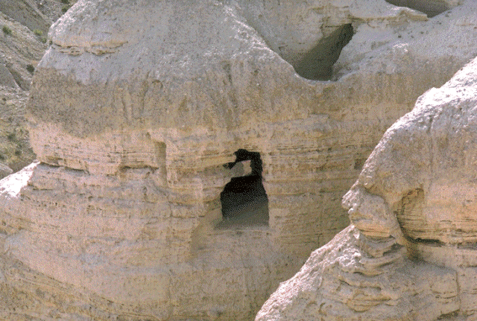
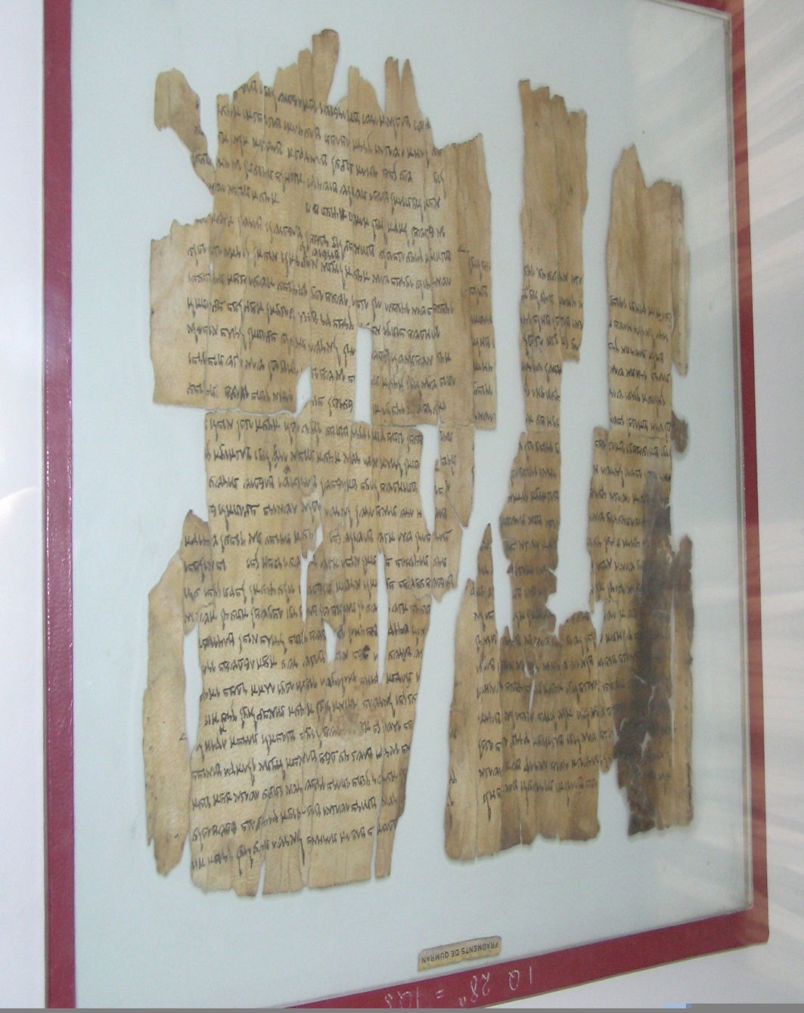
Dead Sea Scrolls

Slide 37
How We Received Our Bible John 14:6 Koine Greek New Testament
le,gei auvtw/| o` VIhsou/j\ evgw, eivmi h` o`do.j kai. h` avlh,qeia kai. h` zwh,\ ouvdei.j e;rcetai pro.j to.n pate,ra eiv mh. diV evmou/Å

Slide 38
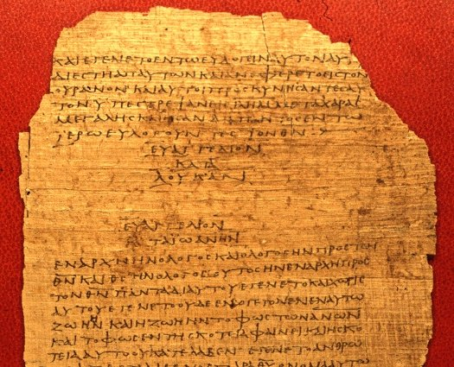
A Sample Portion of a Papyrus Manuscript: Bodmer XV (P⁷⁵), ca. A.D. 175-225

Slide 39
A Sample Portion of an Uncial Manuscript: Codex Vaticanus (B), early 4th century

Slide 40
How We Received Our Bible Early Bible Translations
Purpose: To get the Bible in a language that the people could understand
Old Testament
Koine Greek: Septuagint (LXX) 3rd Century B.C.
Syriac: Peshitta 2-3rd Century A.D.?
Aramaic: Jewish Targums 2-3rd Century A.D.
Latin: Vulgate done by Jerome 400 A.D.
New Testament (Early Translations in 2nd century A.D.)
Latin: Old Latin and Vulgate (Western Church)
Coptic: (Egypt)
Syriac: Old Syriac and Peshitta (Eastern Church)

Slide 41
How We Received Our Bible History of the English Bible
John Wycliffe (1330-1384)
First Complete English Translation
Translated from the Vulgate
Matt 22:37-40: Thou schalt love thi Lord God of al thin herte, and of al thi soule and of al thi mynde, and thi neighebore as thi self, for in these twey comaundements hangith al the lawe and prophetis
Copied by hand
In 1415 Wycliffe Bible was condemned by the church. His followers were jailed, Wycliffes bones were dug up, burned and ashes scattered in a river.

Slide 42
How We Received Our Bible History of the English Bible
William Tyndale (1492-1536)
Used Greek and Hebrew mss. for translation.
Motivation: I will cause a boy that driveth a plow to know more of the Scripture than a learned scholar.
John 14:6: Iesus sayd vnto him: I am the waye verite and lyfe. Noman cometh vnto the father but by me.
6000 printed copies smuggled into England. First complete printed edition of English Bible
Hounded and eventually burned at the stake for the translation. Prayed as being burned “Lord open the King’s eyes.”

Slide 43
How We Received Our Bible History of the English Bible
God answered Tyndale’s Prayer
King began to allow the English Bible into the church
The Coverdale Bible (1535); Matthew’s Bible (1537); The Tavner Bible (1539); The Great Bible (1539); The Geneva Bible (1560; Bible used by the Pilgrims); The Bishops Bible (1568); The Douai-Rheims Bible (1609-10)
These were largely revisions of each other

Slide 44
How We Received Our Bible History of the English Bible
In 1603 King James I took the throne of England. He was unhappy with the Calvinist notes in Geneva Bible and the anti-protestant notes in the Douay-Rheims Bible. Wanted to have one standard Bible for the English church.
Supported 50 scholar/translators to complete the King James Bible in 1611.
Controlled the English presses
Translation underwent revisions in 1629, 1638, 1762, 1769 (Current KJV), 1982 (NKJV)

Slide 45
How We Received Our Bible History of the English Bible
1885 Revised Version (British)
1901 American Standard Version
1952 Revised Standard Version; 1989 NRSV (Prot.)
1958 The Phillips Bible (Evang.)
1960/95 The New American Standard Bible (Evang.)
1966 Jerusalem Bible; 1985 NJB (Catholic)
1971 The Living Bible; 1996 New Living Translation (Evang.)
1979 New International Version (Evang.)
1993 The Message (Evang.)
1995 Contemporary English Version (Evang.)
2004 Holman Christian Standard Bible (Evang.)
2005 The NET Bible

Slide 46
How We Received Our Bible Types of Bible Translations
Dynamic Equivalence
Translation seeks to express the meaning of the text in a way that is idiomatic in English. More concerned about good stylistic English and willing to forgo some literalness to accomplish objective. Usually easier to read and understand; more interpretive (what text means)
Examples: NIV, NLT, CEV, (NET and HCSB in part)

Slide 47
How We Received Our Bible History of the English Bible
Word Equivalence:
Translation is more literal to the language structure of the original text. Translation seeks to produce the semantic equivalence of each word and represent it in the translation. Usually harder to read; sometimes can confuse what author means with unfamiliar idiom; less interpretive in translation and allows more interpretive options (what text says not what it means necessarily)
Examples: NASB, NKJV, RSV (NET and HCSB in part)

Slide 48
How We Received Our Bible History of the English Bible
Paraphrase
Not a translation from the original language, but someone putting something in their own words as to how they would say it.
Examples: Living Bible, The Message

Slide 49
Comparison of Ps 1:1
NASB Word Equivalence | HCSB Dynamic Equivalence | The Message Paraphrase
How blessed is the man who does not walk in the counsel of the wicked, nor stand in the path of sinners, nor sit in the seat of scoffers. | How happy is the man who does not follow the advice of the wicked, or take the path of sinners, or join a group of mockers. | How well God must like you– you don’t hang out at Sin Saloon, you don’t slink along Dead-End Road, you don’t go to Smart-Mouth College.

Slide 50
How We Received Our Bible Concluding Reflections
“God’s words will give men new life more than other words that are for pleasure. O marvelous power of the Divine Seed which overpowers strong men in arms, softens hard hearts, and renews and changes into godly men, those men who had been brutalized by sins and departed infinitely far from God.” --- John Wycliffe

Slide 51
Discussion Questions
If we as Christians believe the Bible is inspired by God and inerrant how should this affect our interaction with it?
What challenges to the reliability of the Bible have you encountered? How have you responded?
What are some questions you have about what books are included in the canon and what books are not? Are you comfortable with it?
Are there any differences in the Bible that you think are very difficult or cannot be reconciled? What are they?

Slide 52
Discussion Questions
What are some of the advantages and disadvantages of having so many Bible translations?
What Bible translation do you like and why?
How does the fact that Tyndale died to get the English Bible done help you appreciate the Bible we have?

