Slide 1
Study of Christ
Lesson 7: Core Faith
James F. Davis, PhD

Slide 2
Copyright Notice
You may download this presentation on your computer for personal study or you can print it or use it in a multimedia presentation for yourself and others as long as you give the printed material away and do not charge for it. In this case, free means free. It cannot be bundled with anything sold, nor can you charge for shipping, handling, or anything. It cannot be posted on other websites or servers. It is provided for personal study or for use in preparation and presentation of sermons, Sunday school classes, undergraduate or seminary religion classes or other non-commercial study. Material in the presentation may be edited (added to , deleted or changed) on the condition that no revision contradicts the Bible.org doctrinal statement and that substantive revisions are identified as being the work of a reviser and not that of Dr. Davis.

Slide 3
Who is Jesus?
Jesus once asked the question of His disciples, “Who do men say that I am” and after some answers quickly followed with a second more important question, “But you do you say that I am.”
This is life’s greatest question and our whole eternity is hinging on the correct response.

Slide 4
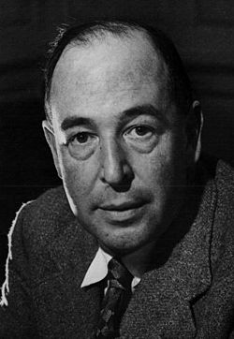
C. S. Lewis
A man who was merely a man and said the sort of things Jesus said would not be a great moral teacher. He would either be a lunatic – on a level with the man who says he is a poached egg – or else he would be the Devil of Hell. You must make your choice. Either this man was, and is, the Son of God; or else a madman or something worse. You can shut Him up for a fool, you can spit at Him and kill him as a demon; or you can fall at His feet and call Him Lord and God. But let us not come with any patronizing nonsense about His being a great human teacher. He has not left that open to us. He did not intend to.

Slide 5
Overview of Lesson
The Preexistence and Eternity of Christ
Christ in the Old Testament
The Incarnation of Christ
The Humanity of Christ
The Deity of Christ
The First Advent Earthly Ministry of Christ
The Passion of Christ
The Resurrected and Ascension of Christ
The Current Ministry of Christ
The Future Return of Christ and Earthly Reign

Slide 6
The Eternality and Preexistence of Christ
The eternality of the Messiah was stated as early as on the Old Testament verse of Is 9:6: “For a child has been born to us a son has been given to us. He shoulders responsibility and is called: . . ., Everlasting Father
John states, “In the beginning was the Word, and the Word was with God, and the Word was fully God. The Word was with God in the beginning . . . The Word became flesh (John 1:1-2, 14).

Slide 7
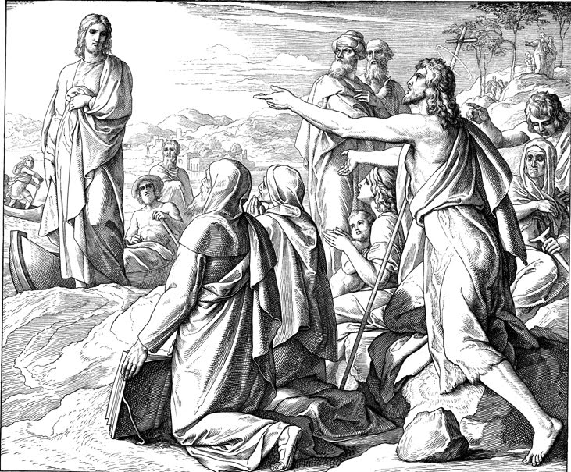
The Eternality and Preexistence of Christ
John the Baptist’s testimony even though he was older than Jesus:
On the next day John saw Jesus coming toward him and said, “Look, the Lamb of God who takes away the sin of the world! This is the one about whom I said, ‘After me comes a man who is greater than I am, because he existed before me.’ (John 1:29-30)

Slide 8
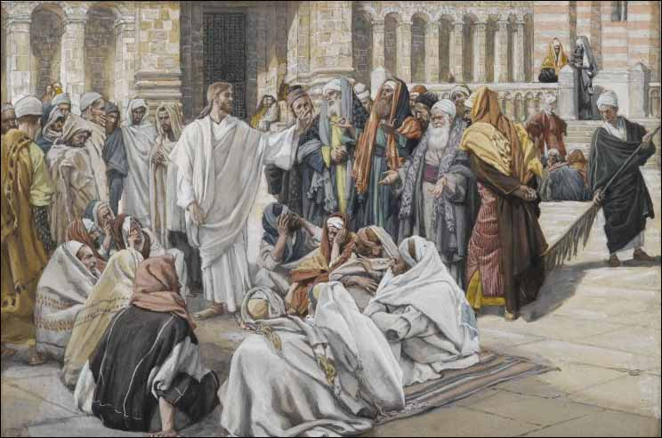
The Eternality and Preexistence of Christ
Jesus’ testimony about Himself:
The Judeans replied, “You are not yet fifty years old! Have you seen Abraham?” Jesus said to them, “I tell you the solemn truth, before Abraham came into existence, I am!” John 8:57-58.

Slide 9
Christ in the Old Testament
We should expect to find Christ in the Old Testament.
Then he [Jesus] said to them, “These are my words that I spoke to you while I was still with you, that everything written about me in the law of Moses and the prophets and the psalms must be fulfilled” (Luke 24:44).

Slide 10
Christ in the Old Testament
1. In Direct Prophecy:
For this reason the sovereign master himself will give you a confirming sign. Look, this young woman is about to conceive and will give birth to a son. You, young woman, will name him Immanuel (Is 7:14; cf Matt 1:23).
2. In Typological Prophecy:
The Passover in Exod 12
For Christ, our Passover lamb, has been sacrificed (1 Cor 5:7).

Slide 11
Christ in the Old Testament
3. In manifestations of God himself. These are sometimes called Theophanies or Christophanies.
Angel of the Lord in the OT who is equated with God in Exod 3:1-6 followed Israel as a cloud by day and a pillar of fire by night (Exod 13:21; 14:19).
For they [the Israelites in the wilderness] were all drinking from the spiritual rock that followed them, and the rock was Christ (1 Cor 10:4 cf. Exod 17:6).

Slide 12
The Incarnation of Christ
Incarnation: “Meaning ‘in flesh’ the incarnation defines the act wherein the eternal God, the Son took to Himself an additional nature, humanity, through the virgin.”
Now the Word became flesh and took up residence among us (John 1:14).
Christ Jesus . . who though he existed in the form of God did not regard equality with God as something to be grasped, but emptied himself by taking on the form of a slave, by looking like other men, and by sharing in human nature (Phil 2:6-7).
The Son of God became the Son of Man so that the sons of men might become the sons of God. (C.S. Lewis)

Slide 13
The Humanity of Christ
And the child grew and became strong, filled with wisdom, and the favor of God was upon him (Luke 2:40).
Jesus had the titles and lineage of Son of Man (Matt 8:20) and Son of Abraham and David (Matt 1:1).
As a man Jesus was
Hungry (Matt 4:2)
Thirsty (John 19:28)
Grew tired (John 4:6)
Grieved to the point of tears (John 11:35)
Tempted (Matt 4:1)
Experienced physical death (Luke 23:46)
He was one of us

Slide 14
The Deity of Christ
Jesus stated, “The Father and I are one.”(John 10:30)
Jesus had the titles of Son of God (John 10:36) as well as Lord and God (Matt 8:20)
He is equated with Yahweh in the OT (1 Cor 2:16)
As a God Jesus
Was Creator (Col 1:15-16)
Had power over nature (Matt 8:26)
Had power over death (John 11)
Forgave sin (Mark 2:1-12)
Rules as God (Heb 1:8)
He was the exact representation of God inwardly and outwardly (Heb 1:1-4)

Slide 15
Hypostatic Union
Articulated at the Council of Chalcedon.
A simple definition is: Jesus Christ is fully God and fully man (= two natures) united in one person.
Jesus is the God-Man

Slide 16
Martin Luther
Martin Luther well stated, “If Christ does not remain the true natural God . . . then we are lost. For what good would be the suffering and death of the Lord Christ do me if He were merely a man such as you and I are? Then He would not have been able to overcome the Devil, death and sin. He would have been far too weak for them and could not have helped us.

Slide 17
The Roles of Jesus
Prophet (First Advent),
Priest (Death on the Cross and Current Ministry) and
King (His rule now from heaven and in the future on earth)

Slide 18
The Passion of Christ
About one third of the gospels cover the last week of Jesus’ life. This shows the importance of these events to the gospel writers.
For even the Son of Man did not come to be served but to serve, and to give his life as a ransom for many (Mark 10:25)

Slide 19
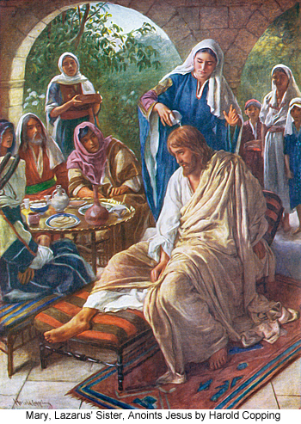
The Passion of Christ
Saturday: Jesus arrives at Bethany at the home of Mary, Martha and Lazarus (Matt 26:6-13; Mark 14:3-9; John 11:55-12:11.) Town is near the Mount of Olives a short walk to Jerusalem. Here Jesus is anointed (“For Burial” (Jn 12:7) with the expensive oil.

Slide 20
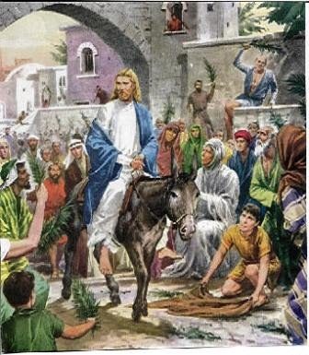
The Passion of Christ
Sunday: The Triumphal Entry: Matt 21:1-11; Mark 11:1-11; Luke 19:29-44; John 12:12-19).
Here the people shout out, “Hosanna to the Son of David” = Save now, the promised Messiah

Slide 21
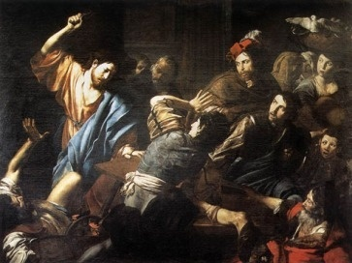
The Passion of Christ
Monday: The Cleansing of the Temple and Cursing of the Fig Tree: Matt 21:12-19; Mark 11:12:18; Luke 19:45-48).
‘My house will be called a house of prayer,’ but you are turning it into a den of robbers!” (Matt 21:13)

Slide 22
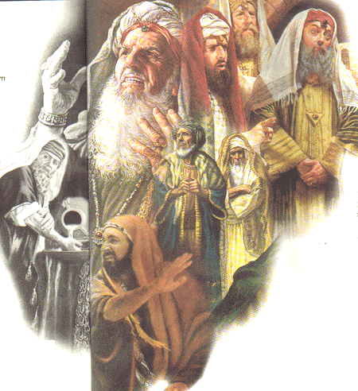
The Passion of Christ
Tuesday:Jesus’ Authority Debated with the Jewish Leadership (Pharisees, Herodians, Sadducees; Matt 21:23-23; Mark 11:27-12:40; Luke 20:1-47).
The Widow’s Mite (Mark 12:41-44; Luke 21:1-4)
The Olivet Discourse (Matt 24-25; Mark 13:1-37; Luke 21:5-36); “Be ready for the coming of the Son of Man.

Slide 23
The Passion of Christ
Thursday: The Betrayal (Mt 26:17-25; Mk 14: 12-21; Luke 22: 7-13, 21-23)
Washing the Disciples Feet (Jn 13:1-20)
The Last Supper (Mt 26:26-29; Mk 14:22-25; Lk 22:17-20) and the Upper Room Discourse (John 14-17)
Prayer in Gethsemene (Mt 26:30, 36-46; Mk 14: 26, 32-42; Lk 22: 39-46; John 18:1)
The Arrest (Mt 26:47-56; Mk 14:43-52; Lk 22:47-53; Jn 18:2-12)
Trials Start

Slide 24
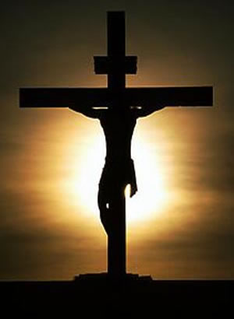
The Passion of Christ
Friday:
Trials Continue (Sanhedrin, Pilate (2x), Herod Antipas)(Matt 26:57-27:31; Mark 14:53-15:15; Luke 22:54-23:25; John 18:12-19:6) Verdict and Scourging
Pilate asked, “Why? What wrong has he done?” But they shouted more insistently, “Crucify him!”
Jesus on the Cross (about 9am-3:00pm (Matt 27:31-34; Mk 15:20-23; Lk 23:26-33; John 19:16-17)

Slide 25
Jesus’ Seven Last Words on the Cross
Father, forgive them; for they do not know what they are doing. (Lk 23:34)
"Truly I say to you, today you shall be with Me in Paradise." (Lk 23:43)
He said to His mother, "Woman, behold, your son! Then He said to the disciple, "Behold, your mother!“ (Jn 19:26-27 )
Eli, Eli, lama sabachthani?" that is, "My God, My God, why hast Thou forsaken Me?" (Mt 27:46)
I am thirsty. (Jn 19:28)
It is finished!" (Jn 19:30)
Father, into Thy hands I commit My spirit." (Lk 23:46 )

Slide 26
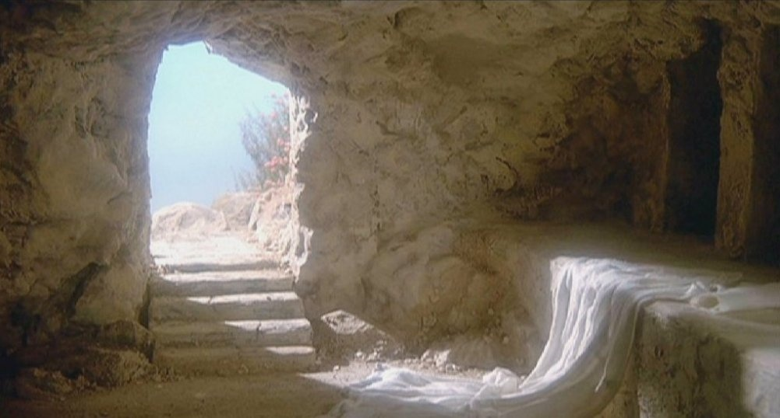
The Resurrection of Christ
Jesus predicted His resurrection (Matt 16:21).
After Jesus died his tomb was guarded by a Roman guard and sealed with the Roman seal (Matt 27:62-66).
Yet the tomb was opened, Jesus came out in a resurrected physical body and it became empty.
He was seen by the disciples and over 500 brethren (1 Cor 15:1-7).
He talked with them and ate with them (Luke 24:39-43).

Slide 27
The Ascension of Christ
After 40 days of being with the disciples Jesus was taken un into heaven from the Mount of Olives
“After he [Jesus] had said this, while they were watching, he was lifted up and a cloud hid him from their sight” (Acts 1:9).

Slide 28
The Current Ministry of Christ
Christ is the head of the body directing the activities of the church.
He [Jesus] is the head of the body, the church (Col 1:18)
Christ as High Priest intercedes in prayer on our behalf.
So he is able to save completely those who come to God through him, because he always lives to intercede for them (Heb 7:25).

Slide 29
Second Coming of Jesus Christ
Can be divided into two major parts:
1) The Coming in Blessing for the Church = The Rapture
For the Lord himself will come down from heaven with a shout of command, with the voice of the archangel, and with the trumpet of God, and the dead in Christ will rise first. Then we who are alive, who are left, will be suddenly caught up together with them in the clouds to meet the Lord in the air. And so we will always be with the Lord. (1 Thess 4:16-17)

Slide 30
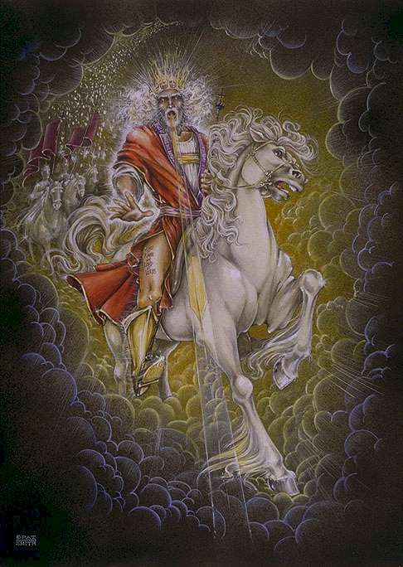
Second Coming of Jesus Christ
2) The Coming in Judgment for the World
Then I saw heaven opened and here came a white horse! The one riding it was called “Faithful” and “True,” and with justice he judges and goes to war (Rev 19:11).

Slide 31
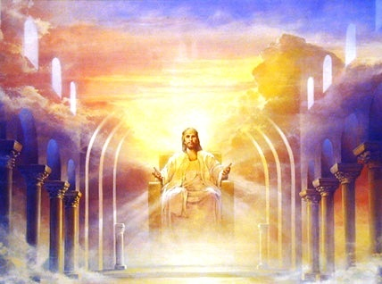
The Future Rule Jesus on Earth
“When the Son of Man comes in His glory, and all the angels with him, then he will sit on his glorious throne (Matt 25:31).

Slide 32
Some of the Names of Jesus
Amazing! Jesus is the Christ, Messiah, Lord, Savior, Alpha and Omega, Son of Man, Son of God, the Son of David, The Word, The Good Shepherd, The Lamb of God, The Bread of Life, The light of the World, Judge, Prophet, Priest, King, Kings of Kings and Lord of Lords and much more.
As John states if everything that that Jesus said and did were recorded there would not be enough books in the world to contain it (John 21:25).

Slide 33
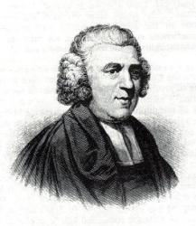
I Saw One Hanging on the Tree by John Newton
I saw One hanging on a tree, In agony and blood; He fixed His loving eyes on me, As near His cross I stood.
Sure, never to my latest breath, Can I forget that look; It seemed to charge me with His death, Though not a word He spoke.
My conscience felt and owned the guilt, And plunged me in despair: I saw my sins His blood had spilt And helped to nail Him there.
A second look He gave, which said, “I freely all forgive: This blood is for your ransom paid, I die that you may live.”

Slide 34
Discussion Questions
How does preexistence differ from the eternality of Christ?
What objections have you heard in regards to the deity of Jesus?
How do the Jehovah witnesses, Mormons or Muslims view Jesus?
Why do you think Jesus did miracles?
Why didn’t the Jewish leadership accept Jesus as Messiah?
Who is responsible for Jesus’ death?
Why was the sacrifice of Jesus necessary for God to forgive sin?

Slide 35
Discussion Questions
What is the evidence for the resurrection and what would the consequences be if Jesus was not raised from the dead?
How should Jesus as head of the church affect us in our local churches? Do people in the church understand this concept?
Why do you think the Bible tells us that Jesus is coming back?
Where is Jesus coming back to and what will He do when He gets there?
PowerPoint template used with permission from ChristianPPT.com

