Slide 1
Study of the Holy Spirit
Core Faith Lesson 8
James F. Davis, PhD

Slide 2
Copyright Notice
You may download this presentation on your computer for personal study or you can print it or use it in a multimedia presentation for yourself and others as long as you give the printed material away and do not charge for it. In this case, free means free. It cannot be bundled with anything sold, nor can you charge for shipping, handling, or anything. It cannot be posted on other websites or servers. It is provided for personal study or for use in preparation and presentation of sermons, Sunday school classes, undergraduate or seminary religion classes or other non-commercial study. Material in the presentation may be edited (added to , deleted or changed) on the condition that no revision contradicts the Bible.org doctrinal statement and that substantive revisions are identified as being the work of a reviser and not that of Dr. Davis.

Slide 3
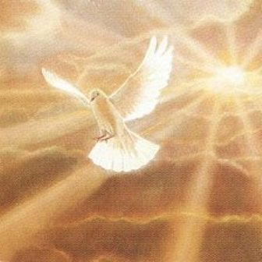
Someone once said: “The average church member’s understanding of the Holy Spirit is so vague it is nearly non-existent.” (Source Bible.org.)
In this lesson we are going to try and help remedy this.

Slide 4
Overview of the Lesson
The Personhood and Deity of the Holy Spirit
The Holy Spirit in the Creation, Revelation and the Old Testament
The Pre-Conversion Work of the Spirit
The Conversion Work of the Spirit
The Post-Conversion (Sanctification) Work of the Spirit
Spiritual Gifts

Slide 5
The Personhood and Deity of the Spirit
The Spirit has attributes that only a person can have
1) intelligence (1 Cor 2:10-13)
2) feelings (Eph 4:30)
3) a will (1 Cor 12:11; Acts 16:6-12)
4) prays (Rom 8:26)
5) does miracles (Acts 8:39)
6) can be lied to (Acts 5:3)
7) can be insulted (Heb 10:29)
8) teaches and directs (John 14:26; Acts 8:29)

Slide 6
The Deity of the Spirit
The Spirit is equated with God:
But Peter said, “Ananias, why has Satan filled your heart to lie to the Holy Spirit and keep back for yourself part of the proceeds from the sale of the land? Before it was sold, did it not belong to you? And when it was sold, was the money not at your disposal? How have you thought up this deed in your heart? You have not lied to people but to God!” (Acts 5:3-4).

Slide 7
The Holy Spirit in Creation
Involved in Creation.
In the beginning God created the heavens and the earth. Now the earth was without shape and empty, and darkness was over the surface of the watery deep, but the Spirit of God was moving over the surface of the water (Gen 1:1-2).
Elihu to Job: The Spirit of God has made me, and the breath of the Almighty gives me life (Job 33:4).

Slide 8
The Holy Spirit in Revelation
Involved in Revelation of God’s word.
In citing Psalm 2 the Peter and John with the church state “Master, who said by the Holy Spirit through your servant David our forefather, ‘Why do the nations rage, and the peoples plot foolish things” (Acts 4:25).
In citing Ps 95 the author of Hebrews states, Therefore, as the Holy Spirit says, “Oh, that today you would listen as he speaks! (Heb 3:7)

Slide 9
The Holy Spirit in the Old Testament
Filled individuals temporarily for various kinds of service. In the NT age the indwelling Spirit is a permanent act.
Then the spirit of God rushed upon Saul ¹⁴ and he prophesied among them. (1 Sam10:9)
Now the Spirit of the Lord had turned away from [departed] Saul, and an evil spirit from the Lord tormented him. (1 Sam 16:14).
When David prayed after his sin with Bathsheba in Ps 51. “Do not reject me! Do not take your Holy Spirit away from me! He did not want what happened to Saul happen to him.

Slide 10
The Preconversion work of the Holy Spirit
Convicting of Sin and Truth
And He (The Helper = Holy Spirit), when He comes, will convict the world concerning sin and righteousness and judgment; concerning sin, because they do not believe in Me; and concerning righteousness, because I go to the Father and you no longer see Me; and concerning judgment, because the ruler of this world has been judged (NASB; John 16:8-10).

Slide 11
The Conversion work of the Holy Spirit
Regeneration:
He [God] saved us not by works of righteousness that we have done but on the basis of his mercy, through the washing of the new birth and the renewing of the Holy Spirit (Titus 3:5).
Peter said to them, "Repent, and each one of you be baptized in the name of Jesus Christ83 for84 the forgiveness of your sins, and you will receive the gift of the Holy Spirit.

Slide 12
The Conversion work of the Holy Spirit
Baptizing into the Body of Christ
For in one Spirit we were all baptized into one body. Whether Jews or Greeks or slaves or free, we were all made to drink of the one Spirit (1 Cor 12:13)

Slide 13
The Conversion work of the Holy Spirit
Indwelling
Do you not know that you are God’s temple and that God’s Spirit lives in you? (1 Cor 3:16)
You, however, are not in the flesh but in the Spirit, if indeed the Spirit of God lives in you. Now if anyone does not have the Spirit of Christ, this person does not belong to him (Rom 8:9)

Slide 14
The Conversion work of the Holy Spirit
Sealing
And when you heard the word of truth (the gospel of your salvation) – when you believed in Christ – you were marked with the seal of the promised Holy Spirit, who is the down payment of our inheritance, until the redemption of God’s own possession, to the praise of his glory (Eph 1:13-14)

Slide 15
The Conversion work of the Holy Spirit
Gifting
Now there are different gifts, but the same Spirit. . . To each person the manifestation of the Spirit is given for the benefit of all (1 Cor 12:4, 7).

Slide 16
Spiritual Gifts
Lists of gifts occur in Rom 12; 1 Cor 12 and Eph 4.
Rom 12: prophecy, service, teaching, exhortation, contributing, leadership, and mercy.
1 Cor 12: apostles, prophets, teachers, miracles, gifts of healing, helps, gifts of leadership, different kinds of tongues; message of wisdom, message of knowledge, faith, discernment of spirits, interpretation of tongues.
Eph 4; apostles, prophets, evangelists, pastors and teachers.

Slide 17
Spiritual Gifts
Points of clarity and agreement (1 Cor 12)
Each Christian has at least one spiritual gift
The Holy Spirit decides what gifts He gives
Not all have the same gift
Gifts are to be used for the benefit of all (Its other focused)
Gifts are to be exercised in love (1 Cor 13)

Slide 18
Spiritual Gifts
Points of difference and disagreement (1 Cor 12)
Is God giving all gifts today, for example the gift of apostleship, prophecy tongues or healing?
There is no clear statement that some gifts have ceased but also one must compare the Scripture with the claim.
The criteria of apostle in the early church is that the person saw the resurrected Jesus (Acts 1:22; 1 Cor 9:1)

Slide 19
Spiritual Gifts
Everyone believes that God can give any gift at anytime but is he giving revelatory or sign gifts today? That is where we need to compare closely the Scripture.
Also for most evangelicals even if one does not hold to all the gifts functioning today this does not rule out God going miracles directly such as healing in response to prayer (James 5:13-18).

Slide 20
The Post-Conversion work of the Holy Spirit
Filling
While the baptism of the Holy Spirit occurs once at conversion the filling of the Spirit can happen multiple times after conversion and is commanded.
But Saul (also known as Paul), filled with the Holy Spirit, stared straight at him (Acts 13:9).
And do not get drunk with wine, which is debauchery, but be filled by the Spirit (Eph 5:18)

Slide 21
The Post-Conversion work of the Holy Spirit
Empowering
But I say, live by the Spirit and you will not carry out the desires of the flesh (Gal 5:16).
But the fruit of the Spirit is love, joy, peace, patience, kindness, goodness, faithfulness, 5:23 gentleness, and self-control (Gal 5:22-23).

Slide 22
The Post-Conversion work of the Holy Spirit
Guiding
For all who are led by the Spirit of God are the sons of God (Rom 8:14).

Slide 23
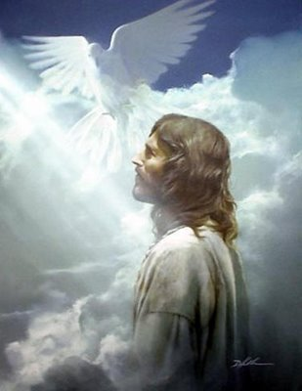
Symbols of the Holy Spirit
The Dove:
“After Jesus was baptized, just as he was coming up out of the water, the heavens opened and he saw the Spirit of God descending like a dove and coming on him” (Matt 3:16).
Inferred is the dove’s 1) beauty, 2) gentleness, 3) peace and 4) coming from heaven (Walvoord, the Holy Spirit, 19)

Slide 24
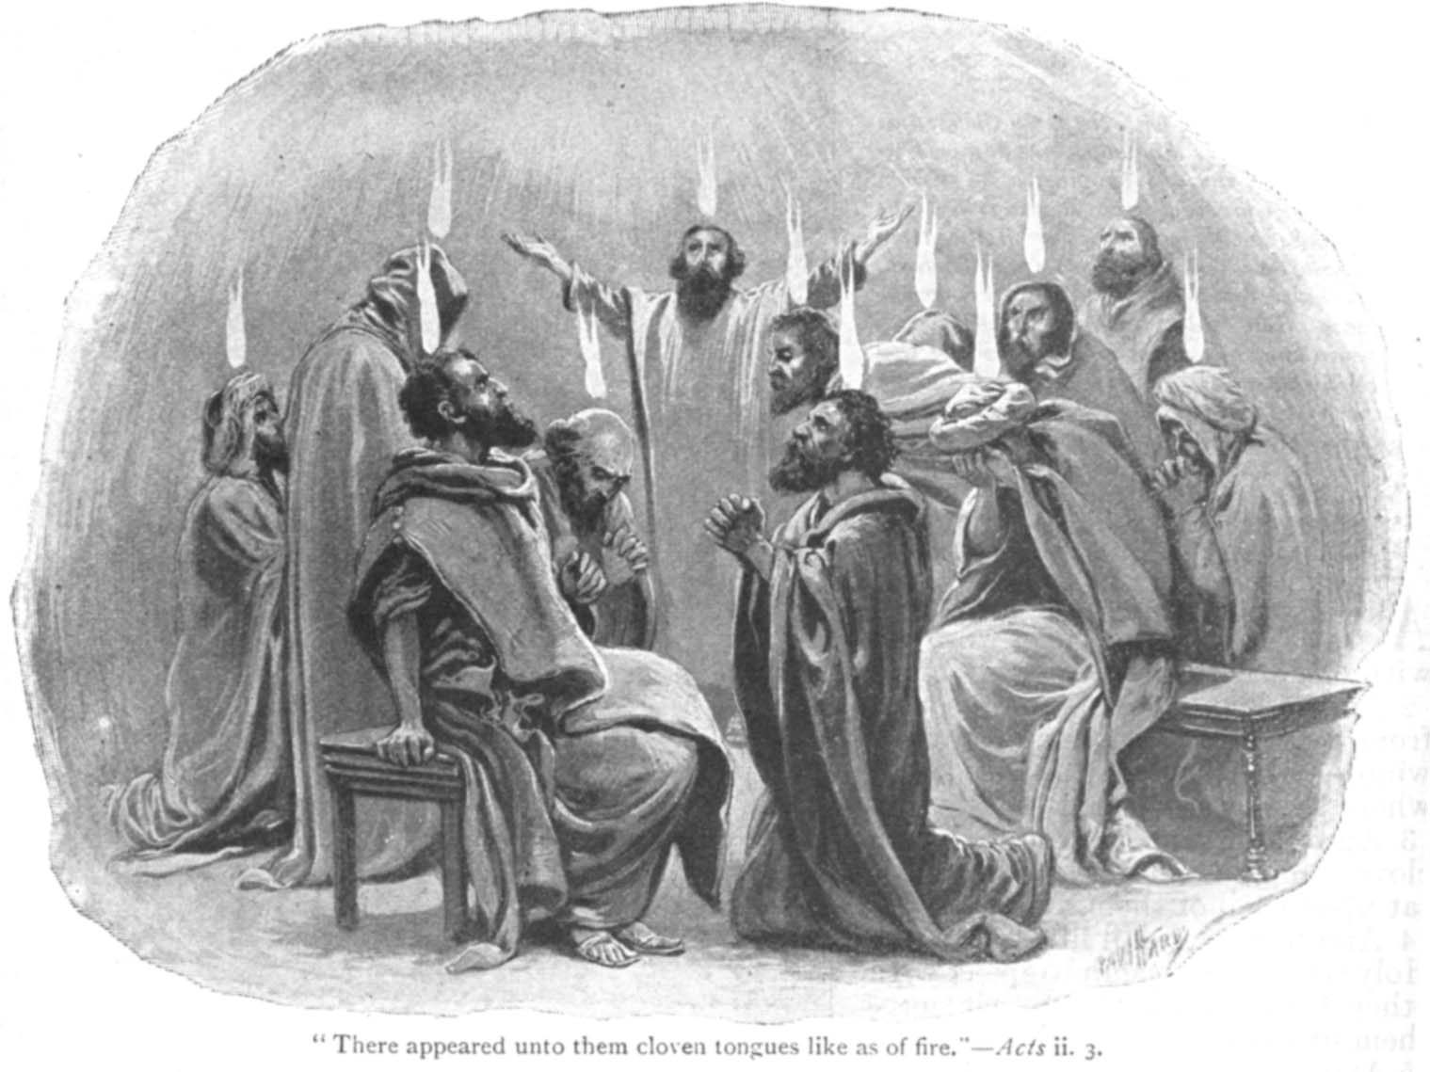
Symbols of the Holy Spirit
Fire:
Now when the day of Pentecost had come, . . tongues spreading out like a fire appeared to them and came to rest on each one of them. All of them were filled with the Holy Spirit (Acts 2:1-4).
Do not quench the Spirit (NASB I Thess 5:19)

Slide 25
Symbols of the Holy Spirit
Wind:
Suddenly a sound like a violent wind blowing came from heaven and filled the entire house where they were sitting (Acts 2:4).
The wind blows wherever it will, and you hear the sound it makes, but do not know where it comes from and where it is going. So it is with everyone who is born of the Spirit (John 3:8)

Slide 26
Symbols of the Holy Spirit
Water:
On the last day of the feast, the greatest day, Jesus stood up and shouted out, "If anyone is thirsty, let him come to me, and let the one who believes in me drink. Just as the scripture says, `From within him will flow rivers of living water.'" (Now he said this about the Spirit, whom those who believed in him were going to receive, for the Spirit had not yet been given, because Jesus was not yet glorified)(John 7:37-39).

Slide 27
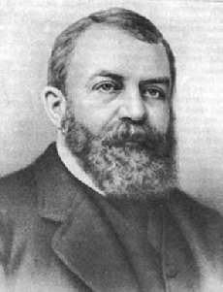
D. L. Moody on the Holy Spirit
You might as well try to hear without ears or breathe without lings, as try to liver a Christian life without the Spirit of God in your heart

Slide 28
Discussion Questions
How would you respond scripturally to someone that said that the Holy Spirit is just an impersonal force like lightening?
In Psalm 51 David prayed to God not to take the Holy Spirit from him. Why did he pray this? Could God take His Holy Spirit from us today?
Does God communicate to us through His Holy Spirit apart from the Bible? If so how and how can we be sure what the message is?
How should the indwelling Holy Spirit affect our daily lives?

Slide 29
Discussion Questions
Can people perform miracles today the same way that the apostles did in the first century?
How would you decide if a spiritual gift is being used in an authentic manner or not? Has some gift ever been claimed where you thought something was not biblical about it?
PowerPoint template used with permission from ChristianPPT.com

