Slide 1
Study of Future Events
Lesson Ten: Core Faith
James F. Davis, PhD

Slide 2
Copyright Notice
You may download this presentation on your computer for personal study or you can print it or use it in a multimedia presentation for yourself and others as long as you give the printed material away and do not charge for it. In this case, free means free. It cannot be bundled with anything sold, nor can you charge for shipping, handling, or anything. It cannot be posted on other websites or servers. It is provided for personal study or for use in preparation and presentation of sermons, Sunday school classes, undergraduate or seminary religion classes or other non-commercial study. Material in the presentation may be edited (added to , deleted or changed) on the condition that no revision contradicts the Bible.org doctrinal statement and that substantive revisions are identified as being the work of a reviser and not that of Dr. Davis.

Slide 3
The World’s Worst Predictions
  King George II said in 1773 that the American colonies had little stomach for revolution.
  An official of the White Star Line, speaking of the firm's newly built flagship, the Titanic, launched in 1912, declared that the ship was unsinkable.
  In 1939 The New York Times said the problem of TV was that people had to glue their eyes to a screen, and that the average American wouldn't have time for it.
  An English astronomy professor said in the early 19th century that air travel at high speed would be impossible because passengers would suffocate.

Slide 4
How do we know that the Bible can predict future events?
Answer is because it has a 100 percent track record of doing so
  Daniel predicted Alexander the Great
  Malachi predicted Jesus would be born in Bethlehem
  Jeremiah predicted the 70 year captivity
  Jesus predicted the destruction of Jerusalem in 70 AD
  And the list goes on and on and on

Slide 5

The Importance of Biblical Prophecy
J. Barton Payne’s Encyclopedia of Biblical Prophecy lists 1,239 prophecies in the Old Testament and 578 prophecies in the New Testament, for a total of 1,817. These encompass 8,352 verses out of 31,102. Thus, about 26-27 percent of the Bible is biblical prophecy

Slide 6
The Importance of Biblical Prophecy
Paul taught detailed events surrounding the second coming of Jesus in Thessalonica after planting a new church there and only being there three weeks.
Thus one would have to conclude that biblical prophecy is important in the Bible and worthy of study.

Slide 7
Overview of the Lesson
1. The Rapture and Great Tribulation
2. The Resurrection
3. The Return of Jesus Christ
4. The Millennium and Future for National Israel
5. Future Judgments, Heaven and Hell
6. What not to Say about the Future

Slide 8
The Teaching of the Rapture
(All evangelicals agree that it will happen)
For we tell you this by the word of the Lord, that we who are alive, who are left until the coming of the Lord, will surely not go ahead of those who have fallen asleep. For the Lord himself will come down from heaven with a shout of command, with the voice of the archangel, and with the trumpet of God, and the dead in Christ will rise first. Then we who are alive, who are left, will be suddenly caught up together with them in the clouds to meet the Lord in the air. And so we will always be with the Lord. (1 Thess 4:15-17)
Listen, I will tell you a mystery: We will not all sleep, but we will all be changed – in a moment, in the blinking of an eye, at the last trumpet. For the trumpet will sound, and the dead will be raised imperishable, and we will be changed (1 Cor 15:51-52).

Slide 9

Rapture Views
  Three major views of “when”
    Pretribulational view (Rapture at begining the of 7 year trib.).
    MidTribulation?Prewrath View ( is in the middle or somewhat after the middle of the 7 year tribulation Period)
    Posttribulational view (Rapture at end of 7 year trib.).

Slide 10
What is the Tribulation?
The “Tribulation” or “Great Tribulation” is an unpredicted time of suffering and trial in the world that immediately precedes the second coming of the Lord.
  Jesus stated, “For then there will be great suffering unlike anything that has happened from the beginning of the world until now, or ever will happen.” (Matt 24:21-22).
  Then one of the elders asked me, “These dressed in long white robes – who are they and where have they come from?” So I said to him, “My lord, you know the answer.” Then he said to me, “These are the ones who have come out of the great tribulation. They have washed their robes and made them white in the blood of the Lamb! (Rev 7:13-14)

Slide 11
What is the Tribulation?
What do we know about this “great tribulation”
  It’s a period that lasts 7 years long (Dan 9:27; Rev 13:5)
  It is a time of God’s wrath (Rev 6:17) and involves at least three series of judgments from God toward the world that are global in nature (Rev 6-18).
  The suffering and conflict will be greater than has ever been seen
  It involves a unique manifestation of evil driven by the Devil, the AntiChrist and the False Prophet (Rev 13).
  People will be faced with a stark choice to repent and worship God or follow evil and receive the consequences of this choice.

Slide 12
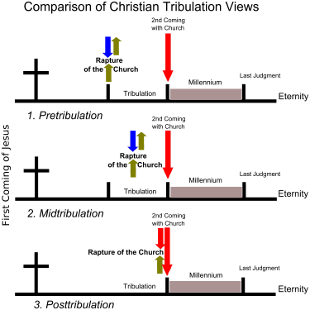

Slide 13
Rapture Views
Basic Arguments for the Postribulation View (Developed in part from George Ladd, The Blessed Hope)
1) There is only one “coming” of Jesus and both the Rapture and Conquest of Jesus must be in the same event after the tribulation.
2) The resurrection mentioned in Revelation 20 at the second coming of Christ in glory suggests that the Rapture which includes the resurrection is there (one resurrection of saints) .
3) Saints (or elect) are seen in the tribulation period in Revelation and this must be the church (Also Matt 24 seems indicates believers go through). The church does not have to be removed from the tribulation to protected from God’s wrath through it.
4) The pretribulation position is a relatively recent development (in part promoted by the writings of JN Darby) not seen in the writings of the early church fathers.
5) The Parable of the Wheat and Tares (Matt 13:24) suggests that believers and unbelievers will be together until the “end of the age.”

Slide 14
Rapture Views
Basic Arguments for the Midtribulation/Prewrath View
1) The Rapture is said in 1 Cor 15 to occur at the “Last Trumpet”. In Revelation there are a series of seven judgments that start with the blowing of trumpets. The seventh trumpet sounds about half the way through this.
2) There is an emphasis in Revelation on 3 and one/half years in the seven year judgment (Rev 11:2-3; 12:6, 14; 13:5 cf. Dan 9:27).
3) The church is delivered from the wrath of God which starts at the mid-point of the tribulation (Rev 15:1).
4) The prewrath rapture view is a development which sees the church going through the midpoint of the tribulation period and undergoing persecution but being taken our sometime prior to the end of the seven year period and before a great outpouring of God’s wrath

Slide 15
Rapture Views
Basic Arguments for the Pretrib Rapture View
  1) Daniel’s 70 week prophecy he states are for “his people” (Dan 9:24). This must refer to national Israel and since the first 69 weeks primarily refer to the time when God is focusing His program on the nation of Israel it makes sense that the 70th week would as well. The 70th week, a seven year period, is the same length of time of the tribulation period and the Daniel’s events fit well with a future tribulational framework (abomination of desolation (Matt 24:15), etc);

Slide 16
Rapture Views
  2) While the church is explicitly mentioned many times in Rev 2-3 it is not explicitly mentioned once in chapters 4-19. It is true that believers are described Rev 7:9-17 but they are not described as the “church.” During Rev 4-19 the focus appears to be on the tribes of Israel (Rev 7:1-8)
  3) In Rev 3:10 it appears to me that the church is to be kept from the hour or time of trial that is coming on the whole world, not protected through it. We are not just kept from the trial but kept from the time of it. The phrase “to test those who dwell on the earth” (cf. Rev 6:10; 8:13; 11:10; 13:8, 14; 17:2, 8) is God’s purpose for the event and refers to the unbelieving world some of whom will turn in belief to God;
  ;

Slide 17
Rapture Views
  4) lastly, the church is not appointed to wrath (1 Thess 5:9), and it is clear that even from right at the start of the tribulation God’s wrath is unleashed in terrifying force (Rev 6:16-17).

Slide 18
Future Resurrection
  The fact of the Resurrection: Jesus said to her, “I am the resurrection and the life. The one who believes in me will live even if he dies, (John 11:25)
  Jesus’ Resurrection is a Prelude to Ours: But now Christ has been raised from the dead, the firstfruits of those who have fallen asleep (1 Cor 15:20).
  The nature of the resurrection body: It is the same with the resurrection of the dead. What is sown is perishable, what is raised is imperishable. It is sown in dishonor, it is raised in glory; it is sown in weakness, it is raised in power; it is sown a natural body, it is raised a spiritual body (1 Cor 15:42-44)

Slide 19
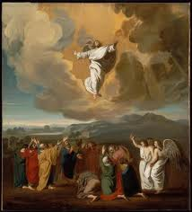
The Ascension of Jesus Christ as Prelude to the Second Coming
After he had said this, while they were watching, he was lifted up and a cloud hid him from their sight. As they were still staring into the sky while he was going, suddenly two men in white clothing stood near them and said, “Men of Galilee, why do you stand here looking up into the sky? This same Jesus who has been taken up from you into heaven will come back in the same way you saw him go into heaven.” (Acts 1:10-11).

Slide 20
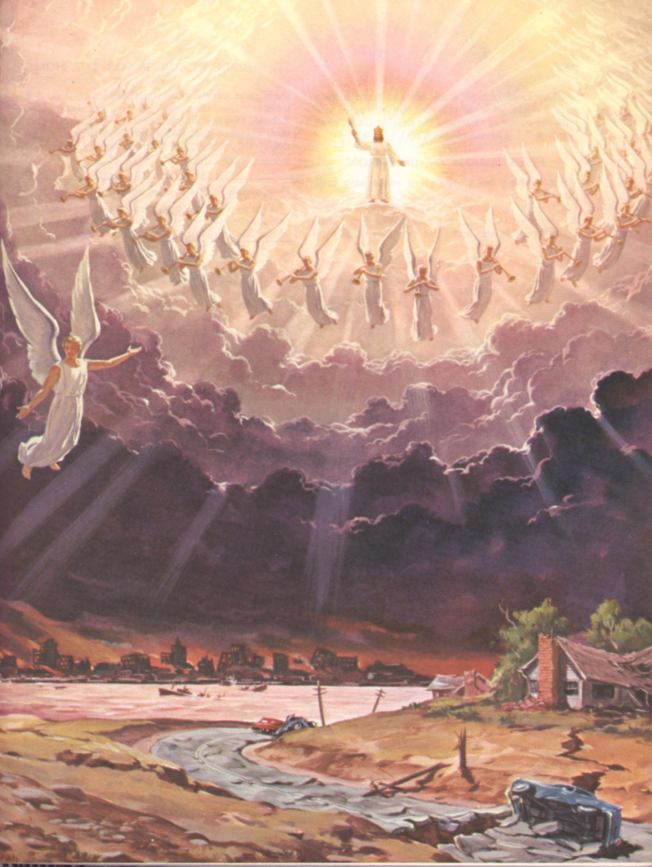
The Second Coming of Jesus Christ
Look! He is returning with the clouds, and every eye will see him, even those who pierced him, and all the tribes on the earth will mourn because of him. This will certainly come to pass! Amen (Rev 1:7)

Slide 21
The Millennial Reign of Christ (Rev 20)
Millennium comes from the Latin word meaning 1000 which is mentioned as the length of this reign 6 times in Revelation 20:1-6.
  Then I saw an angel descending from heaven, holding in his hand the key to the abyss and a huge chain. He seized the dragon – the ancient serpent, who is the devil and Satan – and tied him up for a thousand years. The angel then threw him into the abyss and locked and sealed it so that he could not deceive the nations until the one thousand years were finished. (After these things he must be released for a brief period of time.) Then I saw thrones and seated on them were those who had been given authority to judge. I also saw the souls of those who had been beheaded because of the testimony about Jesus and because of the word of God. These had not worshiped the beast or his image and had refused to receive his mark on their forehead or hand. They came to life and reigned with Christ for a thousand years (Rev 20:1-4).

Slide 22
Basic Comparisons (from R. Griffith)
Amil
Postmil
Premil

Slide 23
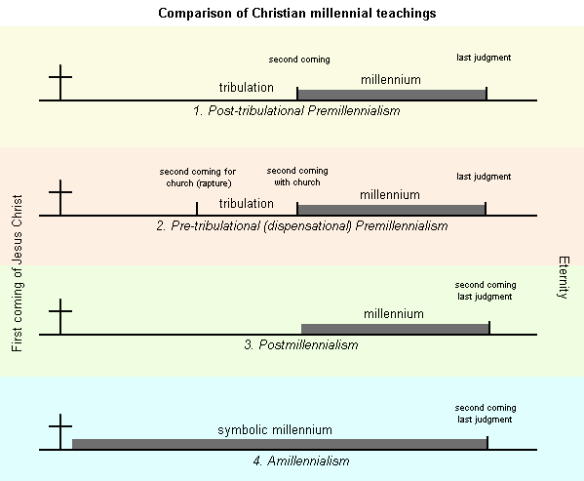
Black

Slide 24
The Millennial Reign of Christ
Amillennial position (the 1000 years are symbolic time between the first and second coming and Satan is currently bound)
  View was introduced by Origen and popularized by Augustine and Jerome (cf. Eusebius).
  Augustine: “Those who, on the strength of this passage, have suspected that the first resurrection is future and bodily, have been moved, among other things, specially by the number of a thousand years, as if it were a fit thing that the saints should thus enjoy a kind of Sabbath-rest during that period, a holy leisure after the labors of the six thousand years since man was created, and was on account of his great sin dismissed from the blessedness of paradise into the woes of this mortal life, . . .

Slide 25
The Millennial Reign of Christ
Augustine (cont.) “And. this opinion would not be objectionable, if it were believed that the joys of the saints in that Sabbath shall be spiritual, and consequent on the presence of God; for I myself, too, once held this opinion. But, as they assert that those who then rise again shall enjoy the leisure of immoderate carnal banquets, furnished with an amount of meat and drink such as not only to shock the feeling of the temperate, but even to surpass the measure of credulity itself, such assertions can be believed only by the carnal. They who do believe them are called by the spiritual Chiliasts, which we may literally reproduce by the name Millenarians. City of God, 20.7. Schaff, P. (2000). The Nicene Fathers (electronic ed.) (Vol. 2). Garland, TX: Galaxie Software.

Slide 26
The Millennial Reign of Christ
Amillennial position: Hoekema argues that the defeat of Satan began with the first coming of Christ (defeated at the cross); Thus Rev 20 which records the judgment of Satan must occur before the second coming (The Meaning of the Millenium, 4 Views).

Slide 27
The Millennial Reign of Christ (Rev 20)
Premillennial position (2nd coming then literal 1000 year reign)
Held by early Christian interpreters (Epistle of Barnabus (about 130 A.D), Papias (60-130 A.D. Irenaeus. Tertullian, Justin Martyr (100-165)
Justin Martyr: “But I and others, who are right-minded Christians on all points, are assured that there will be a resurrection of the dead, and a thousand years in Jerusalem, which will then be built, adorned, and enlarged, [as] the prophets Ezekiel and Isaiah and others declare” (Dia. Try. 80.4). Schaff, P. (2000). The Ante-Nicene Fathers (electronic ed.) (Vol. 1). Garland, TX: Galaxie Software.

Slide 28
The Millennial Reign of Christ (Rev 20)
  Fits chronology of book 2nd Coming in 19 and Millennium in 20
  It will take Christ himself to bring in His kingdom and defeat evil
  Fits OT passages that promise a Messianic kingdom that has not been seen yet
  Other numbers in Revelation may be symbolic but also have a literal referent (e.g., 12 tribes, 7 churches etc)
    1000 years mentioned 6 times
    Whenever time references are given with a number 1260 days 42 months they are always taken literally so it would also be true for years.
    John speaks of an indefinite period of time “a short time” (20:3) which contrasts with a definite period 1000 years

Slide 29
The Millennial Reign of Christ (Rev 20)
  My main objection from the passage is that the purpose of the binding is not currently being fullfilled: The deceiving of the nations. During the period of binding there is not indication of any freedom; the pit is locked and sealed.
  Satan being bound contradicts NT passages
    A roaring lion seeking someone to devour (1 Peter 5:8; long chain?)
    Ananias’ heart was filled with Satan (Acts 5:3)
    He blinds people to the gospel (2 Cor 4:3-4)
    Satan hindered Paul (1 Thess 2:18)
    Christians are alerted to Satan’s temptations (1 Cor 7:5; 2 Cor 2:11; 11:14)

Slide 30
The Millennial Reign of Christ (Rev 20)
Summary of what the Bible teaches: When Jesus comes back he is coming back to earth and when He gets here he defeats his enemies and rules.
When the Son of Man comes in his glory and all the angels with him, then he will sit on his glorious throne (Matt 25:31)

Slide 31
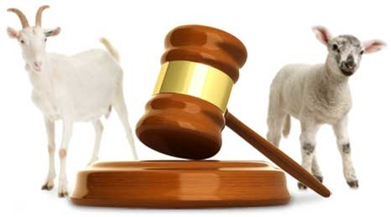
Future Judgments
  The Basic Dividing Line
    The one who believes in him is not condemned. The one who does not believe has been condemned already, because he has not believed in the name of the one and only Son of God (John 3:18).

Slide 32
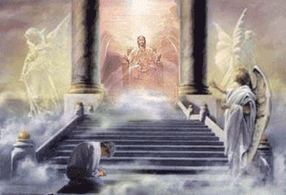
Future Judgments
  The Judgment and condemnation of Unbelievers
    Then I saw a large white throne and the one who was seated on it; . . And I saw the dead, the great and the small, standing before the throne. Then books were opened, and another book was opened – the book of life. So the dead were judged by what was written in the books, according to their deeds. . . If anyone’s name was not found written in the book of life, that person was thrown into the lake of fire (Rev 20:11-15)

Slide 33
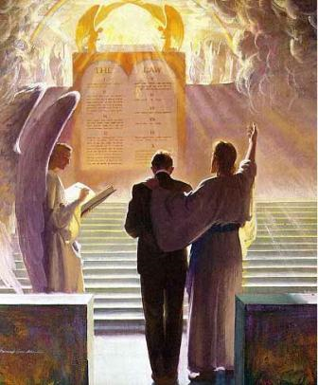
Future Judgments
  The Judgment and Reward of Believers
    For we must all appear before the judgment seat of Christ, so that each one may be paid back according to what he has done while in the body, whether good or evil (2 Cor 5:10).

Slide 34
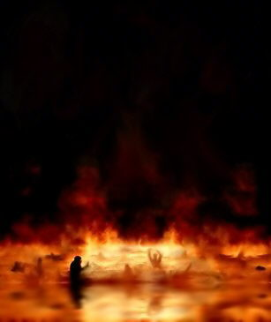
What is Hell Like?
  Greek word for this is “Gehenna”
  A place of fire (Matt 13:30; Luke 3:17)
  Weeping and gnashing of teeth (Matt 8:12)
  Darkness (Matt 8:12)
  Separation from God (1 Thess 1:9)
  Eternal Destruction (2 Thess 1:9)

Slide 35

What is Heaven Like?
  Praising God in His presence, the presence of saints and angels.
  No more sin, death, crying or pain (Rev 21:4)
  In resurrected eternal bodies
  With Jesus forever (1 Thess 4:17)
  With Fellow Saints Forever (1 Thess 4:17)
  New Heavens and New Earth are created (Rev 22)

Slide 36
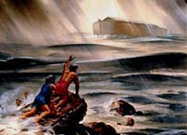
Leave Attempted Predictions of Timing Aside
“But as for that day and hour no one knows it – not even the angels in heaven – except the Father alone. For just like the days of Noah were, so the coming of the Son of Man will be. For in those days before the flood, people were eating and drinking, marrying and giving in marriage, until the day Noah entered the ark. And they knew nothing until the flood came and took them all away. It will be the same at the coming of the Son of Man (Matt 24:36-39).

Slide 37

Be Ready and Live in Light of Jesus’ Future Coming and Our Accountability
Therefore stay alert, because you do not know the day or the hour (Matt 15:13).

Slide 38
Discussion Questions
1. Why do you think the Bible gives us prophecies about the future to think about?
2. What are the most important things to know about the future and how can we live our life in light of them?
3. How do rewards for the Christian motivate us to serve God?
4. How has and does “date setting” for the Lord’s return hurt the church?

Slide 39
Discussion Questions
5. How much leeway should we give our fellow Christians in different views about the future?
6. How does and should God’s sovereignty affect how we think about our personal future and the future of the world?
PowerPoint template used with permission from ChristianPPT.com

